Slide 1

Native Programming
An Introduction to Unreal C++

Slide 2
programming
Introduction to C++ in UE4

Slide 3
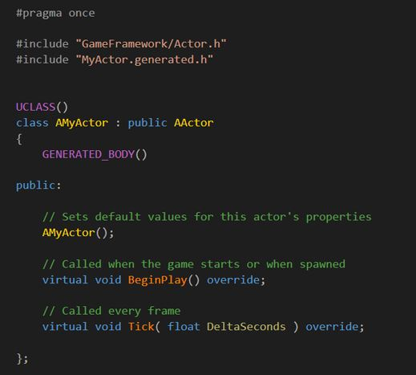

Introduction
While Unreal Engine has a C++ framework, the C++ programming is often referred to as “assisted C++” because of its range of features that make it easier to program in than traditional C++.
This presentation has been written with the assumption that you have some basic programming knowledge of C++. If you don’t but have some experience in C#, Java, or JavaScript, you’ll find many aspects similar.

Slide 4
C++ and blueprints
C++
Unreal Engine provides two methods for creating new gameplay elements, C++ and Blueprints.
Using C++, programmers add the base gameplay systems that designers can then build upon using Blueprint. This allows designers or artists to use the tools familiar to them to modify gameplay or to implement art without being reliant on a programmer.
Both methods are very flexible and can cover most use cases for developing systems; however, there are a few cases where one method presents advantages over the other.
Blueprint
Codebase
Editor
Gameplay

Slide 5
C++ AND BLUEPRINT—POINTS OF DIFFERENCE
Blueprint
C++
Blueprint is simple to use and get started with.
It enables anyone to implement gameplay behavior.
It has a short iteration time—very quick to compile and test inside the editor.
Art implementation is easy using the component editor.
While it can do a lot, its capabilities are limited to what programmers expose to it.
Debugging and development tools are much more mature and powerful in C++.
It is often simpler when multiple people are working on one file, as source control allows you to see differences.
Complex and mathematical operations can be easier to express in C++.
It is generally more performant than Blueprints.
Some parts of the engine are only accessible via C++.
Notes:
Blueprints are an extremely powerful tool for designers. They enable nearly anyone to be able to program gameplay behaviors without taking up engineer time, and they have a very short iteration time, allowing you to quickly create and tweak prototypes and features. Creating and tweaking visual effects is much easier and quicker and can allow artists to implement their own art in engine.
C++, while being more complicated, has a number of strengths. Native debugging tools are much more mature and powerful, making it easier to track down issues. Native source files are much more suitable for source control packages, giving you easy access to merge and diff tools that aren’t reliant on the Unreal Editor.
There are a few areas, such as mathematical operations, that are less verbose and easier to maintain natively than their Blueprint counterparts. There are also a number of areas of the code base that can only be accessed through the C++ API.
Both of these systems are powerful in their own right, but the Engine really shines when these methods are used in conjunction with each other, programmers creating gameplay building blocks in C++ and designers taking those blocks and making interesting gameplay.

Slide 6
core gameplay C++ Base classes
C++ Main Classes
There are four main class types that you derive from for the majority of gameplay classes. They are UObject, AActor, UActorComponent, and UStruct. New class types that do not derive from any of these classes can be developed or implemented, but they will not participate in the features that are built into the engine.
Typical uses of classes that are created outside of the UObject hierarchy often involve such things as integrating third-party libraries and wrapping of OS-specific features.
UObjects and AActors have basic memory management by default, including Garbage Collection.
UObject
AActor
UActorComponent
UStruct

Slide 7
Unreal Objects: UObject
Core features
The base building block in the Unreal Engine is called UObject. This class, coupled with UClass, provides a number of the most important base services in the engine:
Reflection of properties and methods
Serialization of properties
Garbage collection
Finding UObjects by name
Configurable values for properties
Networking support for properties and methods
Most gameplay development does not involve directly deriving from UObjects, but instead from AActor and UActorComponent.
Base class of all objects
Each class that derives from UObject has a singleton UClass created for it that contains all of the metadata about the class instance.

Slide 8
Unreal Objects: AActor
Core features
An AActor is an object that is meant to be part of the interactive experience and is either placed in a level by a designer or created at runtime via gameplay systems. AActor derives from UObject and so features the functionality from the class. AActors can be explicitly destroyed via gameplay code (C++ or Blueprints) or via the standard garbage collection mechanism when the owning level is unloaded from memory.
AActors are responsible for the high-level behaviors of your game’s objects and are the base type that can be replicated during networking.
All AActors must have a root USceneComponent.
An object that is placeable in the world
Can be explicitly destroyed via gameplay code or via garbage collection
The base type that can be replicated during networking
Specialization through inheritance
Acts as component containers for a hierarchy
Before an AActor can be placed in a level, that AActor must contain at least a USceneComponent, which contains the translation, rotation, and scale for that AActor.

Slide 9
Unreal Objects:
UActorComponent
Core features
UActorComponents have their own behaviors and are usually responsible for functionality that is shared across many types of AActors.
While AActors are often given high-level goals related to their overall roles in your game, UActorComponents usually perform the individual tasks that support those higher-level objectives.
Uses of UActorComponents include the following:
Providing visual meshes
Particle effects
Camera perspectives
Physics interactions
Movement logic
Must be parented to an AActor
Child Components within an actor have location, rotation, and scaling relative to their parent Component or Actor.
A Component can only attach to one parent Component or Actor, but it may have many child Components attached to itself, forming a tree.

Slide 10
Unreal Objects:
Ustruct
Core features
A struct (also known as a data structure) is a collection of related data. Like classes, structs can contain functionality, which is typically restricted to the setting, getting, and processing of the data within the struct. A UStruct is Unreal’s specialized version of a C++ struct and is particularly useful at storing and moving around a collection of data.
Unlike UObjects and UActors, you do not have to extend from any particular class to use a UStruct. You just have to mark the struct with USTRUCT() and the Unreal Engine build tools will do the base work for you. Unlike a UObject, UStructs are not garbage collected. If you create dynamic instances of them, you must manage their life cycle yourself.
Does not require extending any class, but rather built into the macro system
Has UObject reflection support for editing within the Unreal Editor, Blueprint manipulation, serialization, networking, and so forth
Does not require explicit
Not garbage collected

Slide 11


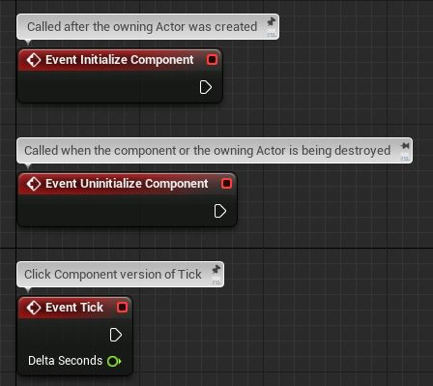
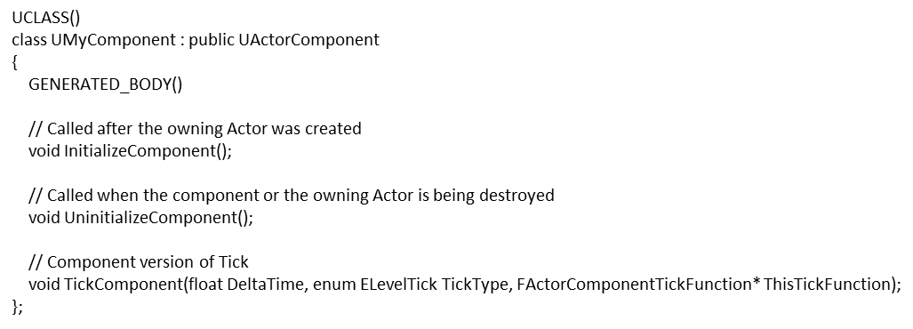
Blueprint
UE4 C++
Blueprint Events
C++ Equivalent
These are an example of some events that you may use inside of an Actor Component Blueprint.
Notice that the names of the events (InitializeComponent, UninitializeComponent and TickComponent) are similar to what you see in Blueprint.

Slide 12
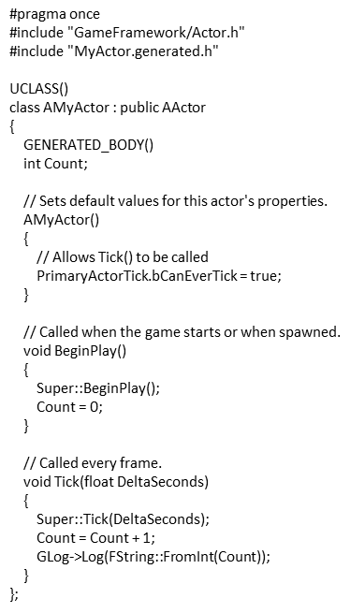
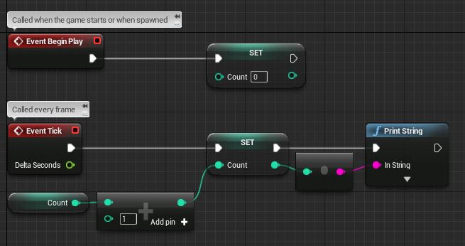
Blueprint
UE4 C++
Blueprint Functionality
C++ Functionality
This is a Blueprint example of incrementing a variable every tick and printing it to the screen. Note the use of BeginPlay and Tick.
This example shows how the same functionality would be implemented in C++. Note that incrementing “Count” by 1 happens in one line, compared to three nodes in Blueprint.

Slide 13
C++ and Blueprints Working Together
When designing a class hierarchy, first you need to identify any common functionality and shared structure between groups of game elements.
These are typically placed in a base class, which can be extended to create the final game elements.
It is common practice to create the base classes in C++ as they often contain greater structural and functional complexity. The final functionality, customization, and art are added in Blueprint.
Sometimes an intermediate base class is added in Blueprint to allow designers and artists to contribute to the common functionality.
Example of C++ and Blueprint interaction

Slide 14

Robo Recall Example:
Character Damage System
Robo Recall has a C++ base class for all characters called “AOdinCharacter”.
Within “AOdinCharacter” is the “TakeDamage” function, which handles how a character responds to being damaged. Most of the tasks involved in “TakeDamage” are common to all Characters.
“AOdinCharacter” also adds a Native Event called “BlueprintModifyPointDamage”, which is called inside “TakeDamage”. When overridden in Blueprint subclasses, this function allows each subclass to take the damage being dealt and make a change to it.
The designers created a large variety of enemy characters in Blueprint for Robo Recall, some of which used “BlueprintModifyPointDamage” to different ends, including the following:
Reducing the damage to 0 if the character was in a state of invincibility
Increasing the amount of damage if a particular weak point was hit
Decreasing the amount of damage if the part of the enemy hit was armored
Diverting the damage to shields if the enemy has shields
Multiplying the damage for drone enemies when in a swarm
Notes:
This example will explain how Robo Recall structured its Character Damage to capture the complexity in the base C++ classes while allowing designers to customize the design of each individual character in Blueprint.
TakeDamage is a function built into the base Actor class. The base character class in C++ (AOdinCharacter) overrides this function to manage the common tasks of handling being damaged, including subtracting that damage from the character’s health, killing the character if its health reaches 0, and notifying various other systems that this character has taken damage.
AOdinCharacter also adds a Native Event called BlueprintModifyPointDamage, which is called inside TakeDamage. When overridden in Blueprint subclasses, this function allows each subclass to take the damage being dealt and make a change to it.
The designers created a large variety of enemy characters in Blueprint for Robo Recall, some of which used BlueprintModifyPointDamage to different ends, including
Reducing the damage to 0 if the character was in a state of invincibility
Increasing the amount of damage if a particular weak point was hit
Decreasing the amount of damage if the part of the enemy hit was armored
Diverting the damage to shields if the enemy has shields
Multiplying the damage for drone enemies when in a swarm

Slide 15
Important Things to Consider When Deciding Whether to Build Functionality in C++ or Blueprint
Which team members are likely to modify the feature?
How complex is the feature?
Does Blueprint support the necessary functionality (for example, the Character Movement Component)?
How can this feature be broken down to ensure ease of customization and iteration?
How many people are likely to work on this feature simultaneously?

Slide 16
Ide setup
Installing Visual Studio 2017

Slide 17
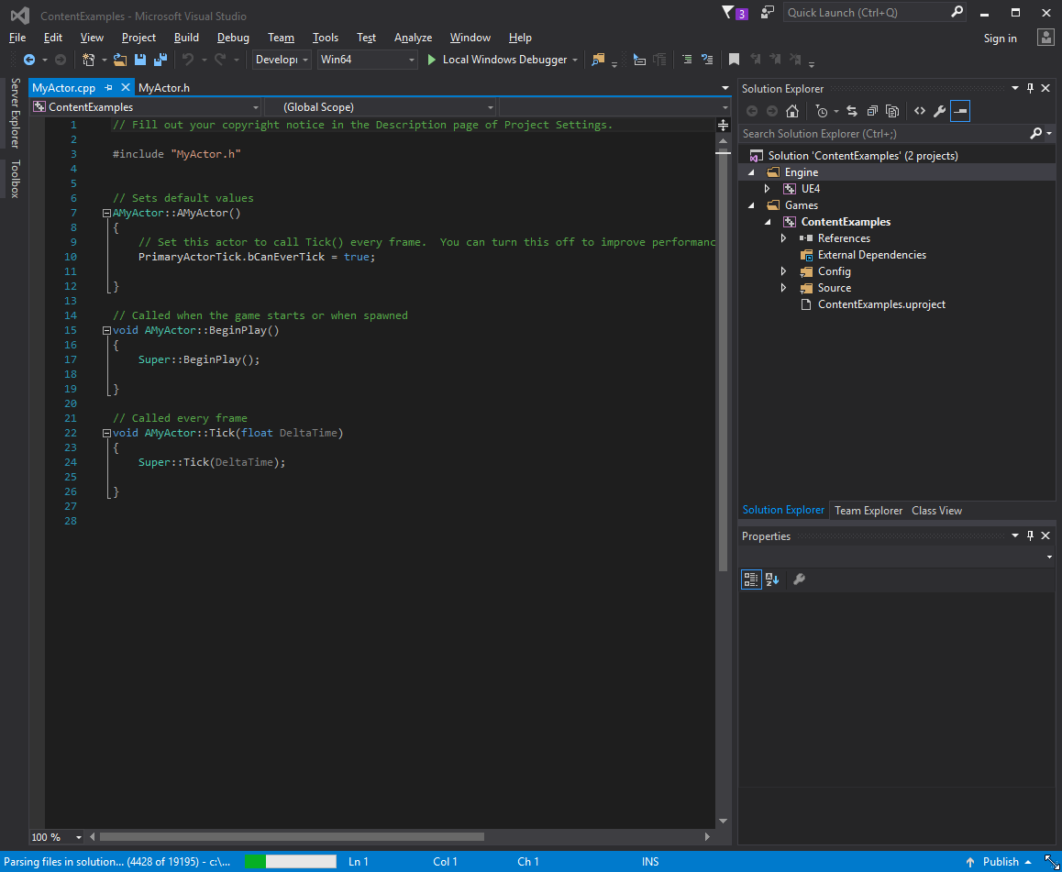
Visual Studio
If you want to start writing C++ code, you need to download and install Visual Studio.
Visual Studio is an integrated development environment (IDE) that allows you to write, compile, and debug code.
Visual Studio 2017 Community Edition is free to use for educational purposes and can be downloaded from www.visualstudio.com.
Notes:
Before we begin, we will need to install Visual Studio. We will be using Visual Studio to edit and compile our native code. Download the latest version of Visual Studio Community Edition and run the installer. It’s important to note that Visual Studio does not install C++ tooling support by default, so you will have to choose Custom installation and then choose the C++ components that you’ll need for your workflow.

Slide 18
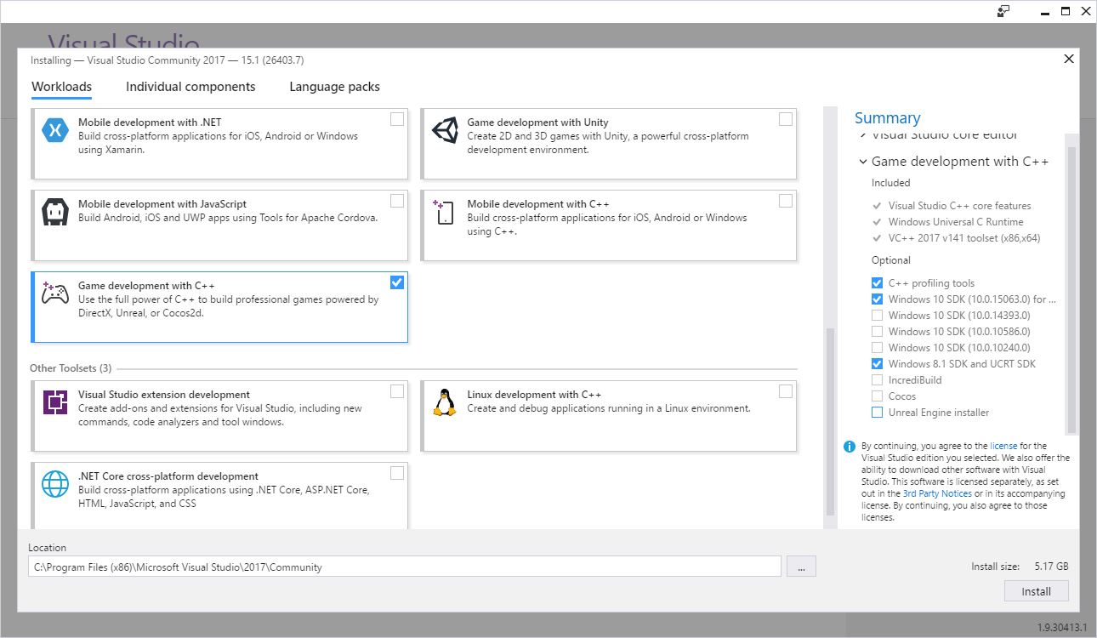
Installing vs2017
Once you install Visual Studio 2017, you need to ensure you select the correct Workload.
Find “Game development with C++” and ensure that it is selected.
On the right-hand side, you should also select “Windows 8.1 SDK” as pictured.
If you intend to do Android development, you can also choose “Visual Studio Android support for Unreal Engine.”
Workload selection in VS2017

Slide 19
C++ project
Creating Your First C++ Project

Slide 20
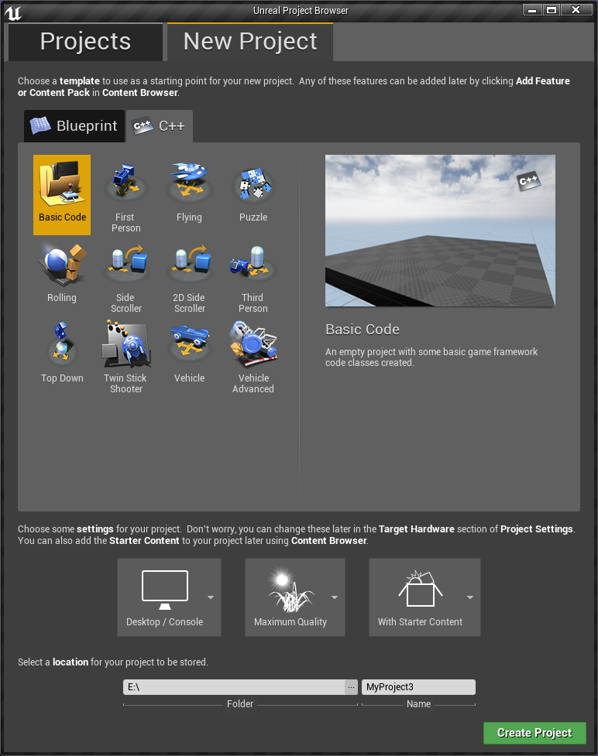
Creating new project
You can create a brand-new UE4 project based off one of the provided templates. However, when selecting the template, make sure to choose the C++ tab so the basic structure is set up for you automatically.
Once this project is set up, the easiest way to add new native classes to your project is via the Class Wizard in the Unreal Engine Editor, which can be accessed via File > Add New C++ Class.

Slide 21
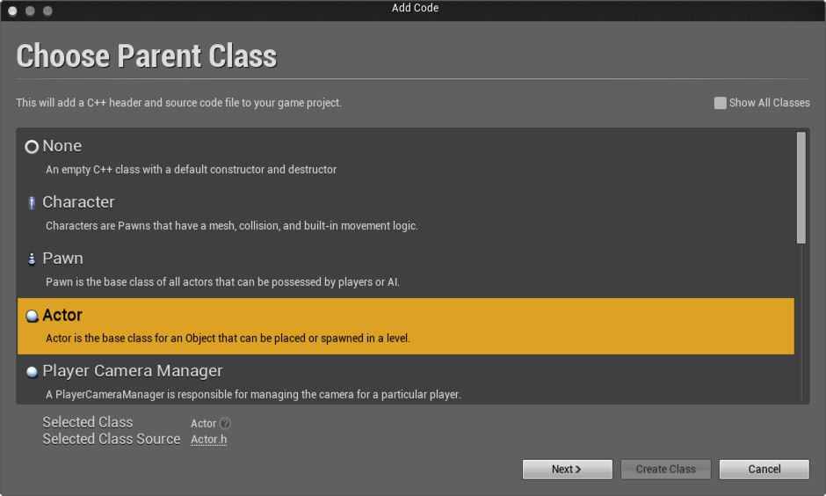
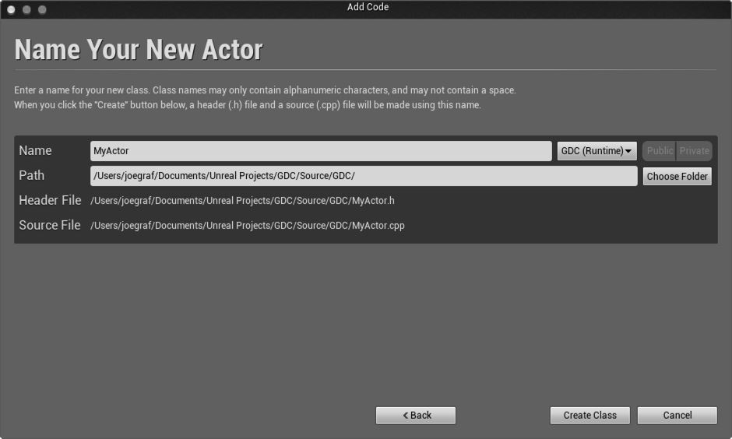
Choose Parent Class menu
Name Your New Actor menu
Creating Parent Class
Naming Your Class
The Choose Parent Class menu presents a list of common classes you might want to create. To see more, check “Show All Classes” in the top right corner.
The Name Your New Actor menu allows you to choose a name for the class that you’re creating. The name should be easy to read, but not too long. In this case, call it MyActor.
Notes:
There are two easy steps involved in creating a new class with the Class Wizard. First select the class you would like to subclass. Initially you are presented with a list of the more popular classes that people would want to be subclassing, but you can see a full list by toggling the “Show All Classes” checkbox in the top right corner.
After you have chosen the class you want to subclass, the only other thing you need to do is to name your class. When you are finished, click the “Create Class” button and the Class Wizard will generate header and source files, open them in Visual Studio ready to be edited, and, by default, compile your new class.

Slide 22
Unreal C++ Supplementation
Class Naming Prefixes
Reflection Macros
Classes derived from Actor are prefixed with A (e.g., AController).
Classes derived from Object are prefixed with U (e.g., UComponent).
Enums are prefixed with E (e.g., EFortificationType).
Interface classes are usually prefixed with I (e.g., IAbilitySystemInterface).
Template classes are prefixed with T (e.g., TArray).
Classes derived from SWidget (Slate UI) are prefixed with S (e.g., SButton).
Everything else is prefixed with the letter F (e.g., FVector).
UCLASS(): Used to tell Unreal to generate reflection data for a class. The class must derive from UObject.
USTRUCT(): Used to tell Unreal to generate reflection data for a struct.
GENERATED_BODY(): Replaced in UE4 with all the necessary boilerplate code that gets generated for the type.
UPROPERTY(): Enables a member variable of a UCLASS or a USTRUCT to be used as a UPROPERTY.
UFUNCTION(): Enables a class method of a UCLASS or a USTRUCT to be used as a UFUNCTION.
UENUM(): Used to tell Unreal to generate reflection data for an enum.

Slide 23
#include "MyObject.generated.h"
UCLASS(Blueprintable)
class UMyObject : public UObject
{
GENERATED_BODY()
public:
MyUObject();
UPROPERTY(BlueprintReadOnly, EditAnywhere)
float ExampleProperty;
UFUNCTION(BlueprintCallable)
void ExampleFunction();
};
Blueprint from C++
The UCLASS, UPROPERTY, and UFUNCTION markups in this example include additional specifiers. These are not required, but some common specifiers have been added for demonstration purposes. These allow us to specify certain behaviors or properties.
Blueprintable: This class can be extended by a Blueprint.
BlueprintReadOnly: This property can be read from a Blueprint, but not written to.
Category: This defines what section this property appears under in the Details view of the Editor. This is helpful for organizational purposes.
BlueprintCallable: This function can be called from Blueprints.

Slide 24
conclusion
Questions?

